Slide 1
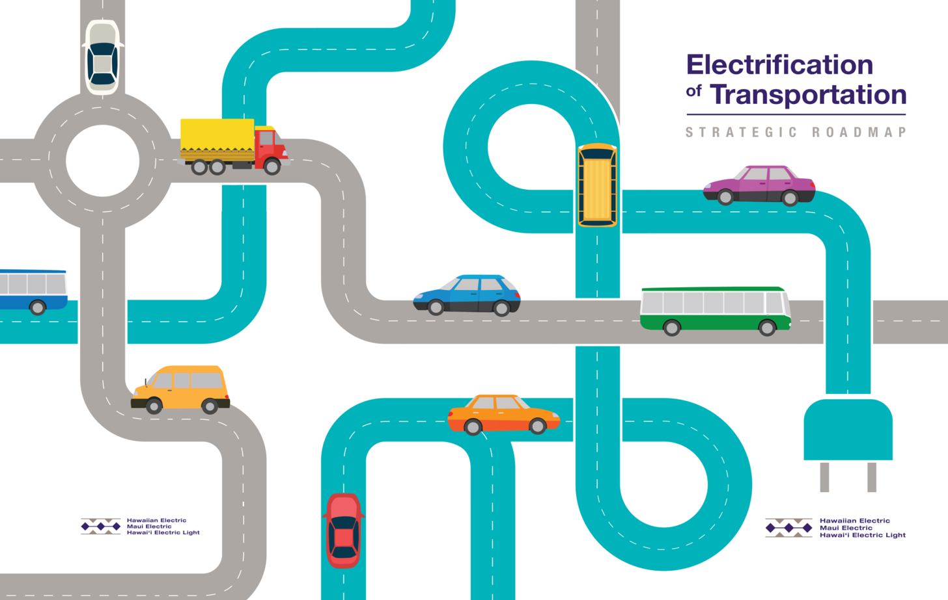

Hawaii Annual Code Challenge (HACC)
Electric Vehicle Charging Analysis

Slide 2
Electrification of Transportation has a significant impact on RPS, climate change, energy security, and grid modernization
State RPS Goal only accounts for 28% of Petroleum use, while Transportation accounts for 61%
Other
3%
Heavy-duty vehicles
7%
Trucks, Buses, etc.
100%
Military
8%
Fuel for vessels
Marine
12%
Electricity Generation
28%
Jet Fuel
70%
Aviation
28%
40%
Transportation
61%
30%
Cars & Light Trucks
53%
26.8% achieved in 2017
15%
2017
2020
2030
2040
2045
Petroleum Use
Transportation
We cannot go it alone—it’s a kākou thing

Slide 3
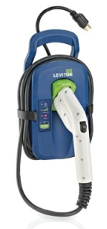

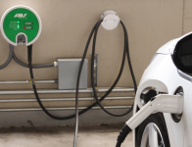

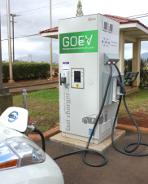
Different Ways to Charge an EV
Charge Level | Rate of Charge | Power | Installation
Level 1 | 4 miles/hour | 1.4 kW | plug into standard 120V outlet
Level 2 | 12-25 miles/hour | 3.3 – 6.6 kW | plug into a 240V outlet, or installed by licensed electrician
DC fast charging | 40 miles/15 minutes | 50 kW+ | requires high powered 3-phase electrical installation
home
condominium
workplace
public
commercial

Slide 4
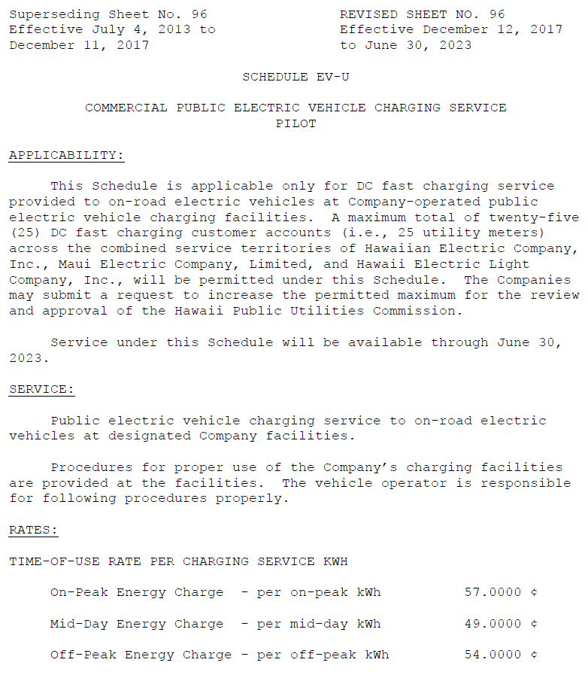
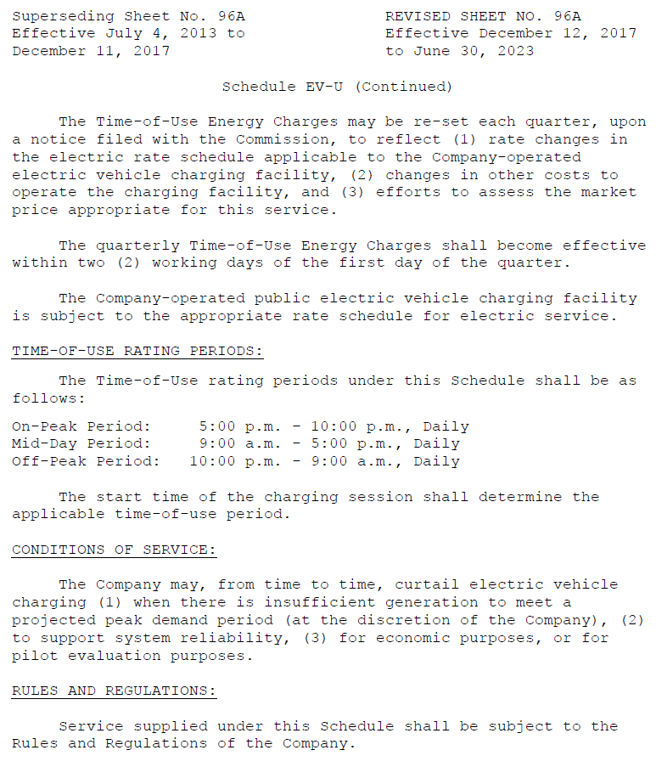
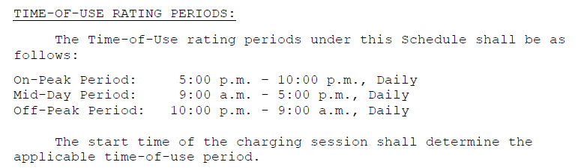
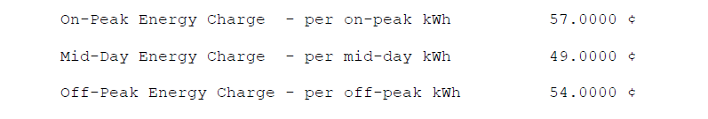
Hawaiian Electric Company’s DC Fast Charging Pilot Program (Hawaiian Electric Tariff)

Slide 5
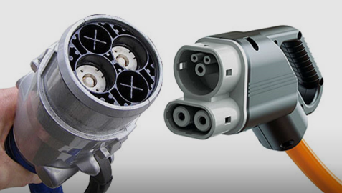
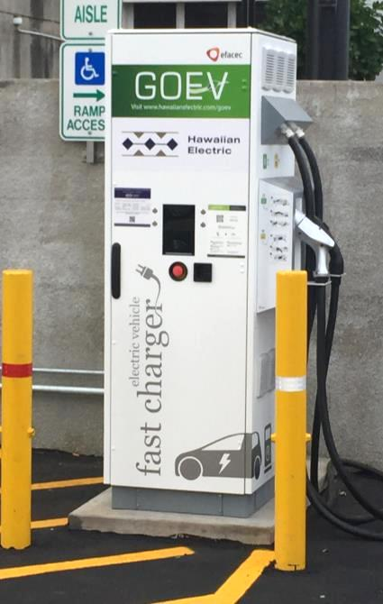
Hawaiian Electric Companies’ DCFC Equipment
CHAdeMO & CCS
Two DCFC charging standards
HMI: screen with four adjacent soft buttons
RFID card reader
POS magnetic card reader
Charge session data, communications heartbeat, some diagnostic codes are send via cellular communications

Slide 6
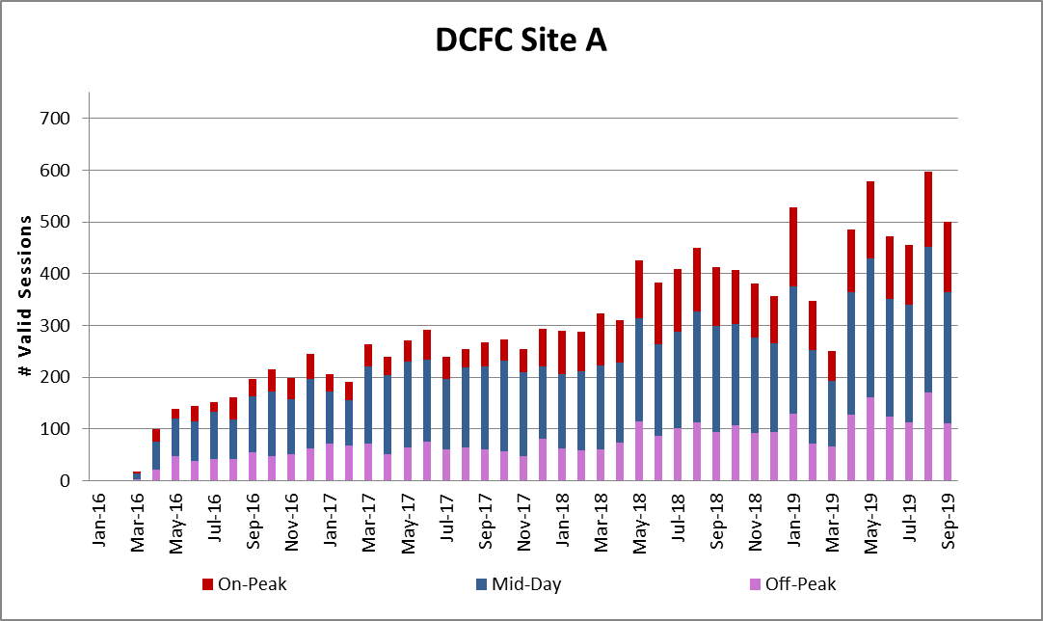
Hawaiian Electric DCFC Usage

Slide 7
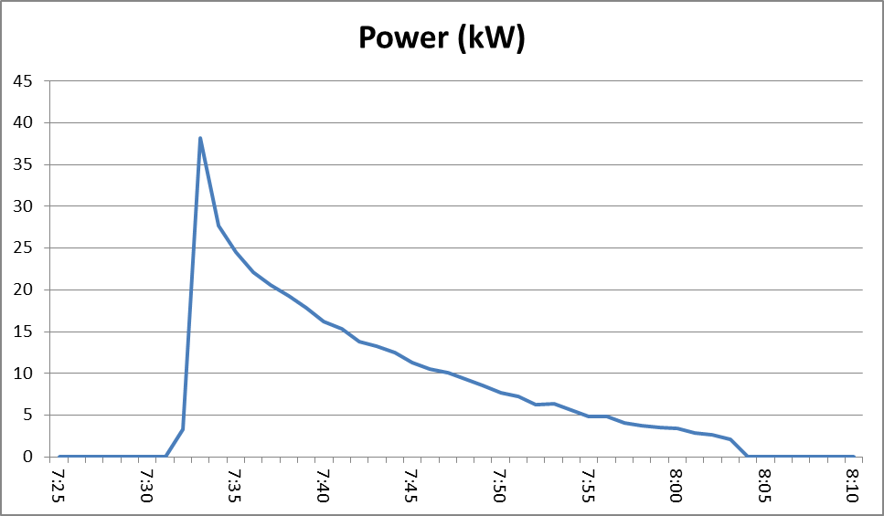
DCFC Session Data
Charge Station Name “A” / “B” Start Time 9/1/2018 7:25 End Time 9/1/2018 7:53 Energy(kWh) 8.84 Session Amount $4.77 Port Type “CHADEMO” / “DCCCOMBOTYP1” Payment Mode “CREDITCARD” CC payment through: mobile app or POS reader “RFID” prepaid through: mobile app or RFID card Session Initiated By “MOBILE” mobile app
“DEVICE” POS reader or RFID card
“WEB” remotely initiated by network call center
Energy(kWh) is area under charging curve
Notes:
Although charging options have grown through the years, there is still much more charging infrastructure necessary to truly develop a robust charging network to provide a backbone enough for the average person who is used to driving and being able to fill up their gasoline car at a gas station on every corner.

Slide 8
Problem Statements
The DCFC equipment provides limited state of health status.
Limited availability of public charging may impact EV adoption.
Session data does not provide an accurate picture of the peak power (kW) required at DCFC stations.
Notes:
Although charging options have grown through the years, there is still much more charging infrastructure necessary to truly develop a robust charging network to provide a backbone enough for the average person who is used to driving and being able to fill up their gasoline car at a gas station on every corner.

